Slide 1
Selenium Demo by Testing Masters

Slide 2
Agenda
What is Testing?
What is Automation Testing?
Why you need Automation?
Automation Tool Selection?
Automation Work Flow

Slide 3
What is Software Testing?
Software testing is an activity to check whether the actual results match the expected results and to ensure that the software system is Defect free.

Slide 4
What is Automation Testing?
Manual Testing is performed by a human sitting in front of a computer carefully executing the test steps.
Automation Testing means using an automation tool to execute your test case suite.

Slide 5
Tools
Selenium – Open, All browsers, All laungauge, Zero cost, Parallel execution support, Cross browser execution also support. Java, c#,.Net,Ruby,Python
UFT – Vb script, Window/Web. Chrome cost more
RPA – Robotic process Automation. / Licence cost
Tosca – Activiticys. Cost.
Cypress – Updated automation tool.
..etc.

Slide 6

Why you need Automation?

Slide 7
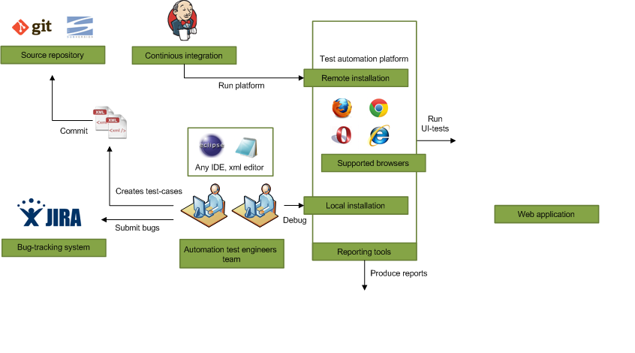


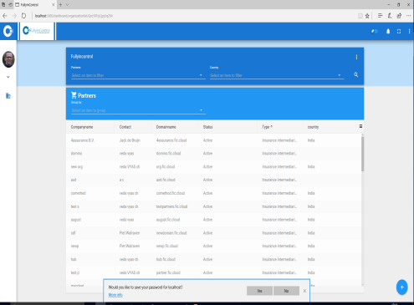
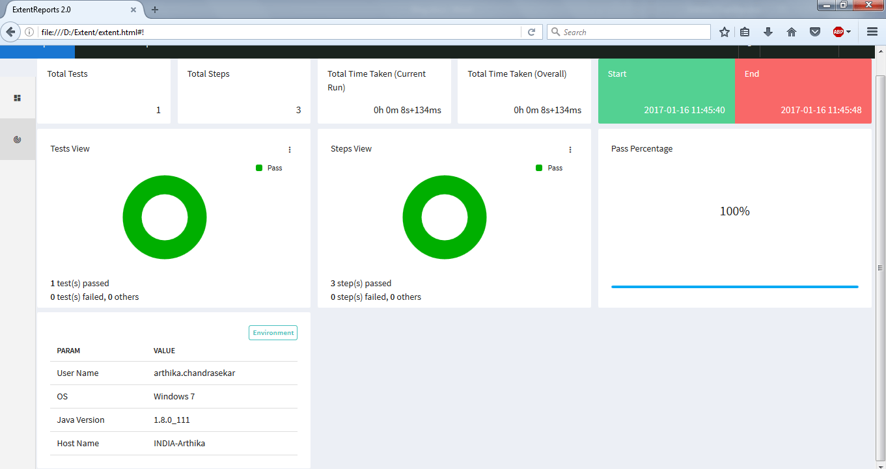
Automation –Work Flow
Build Tool
Web Application
Extent Reports

Slide 8
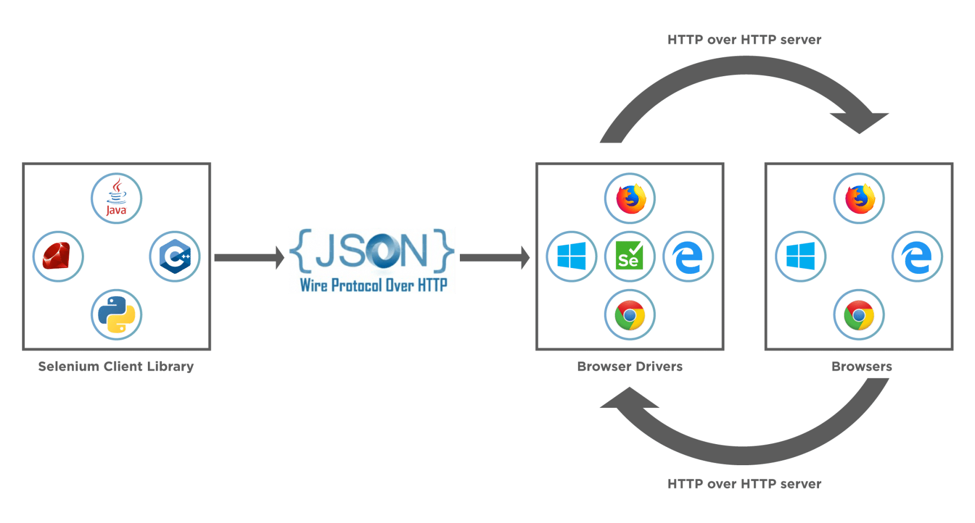
Selenium WebDriver Architecture

Slide 9
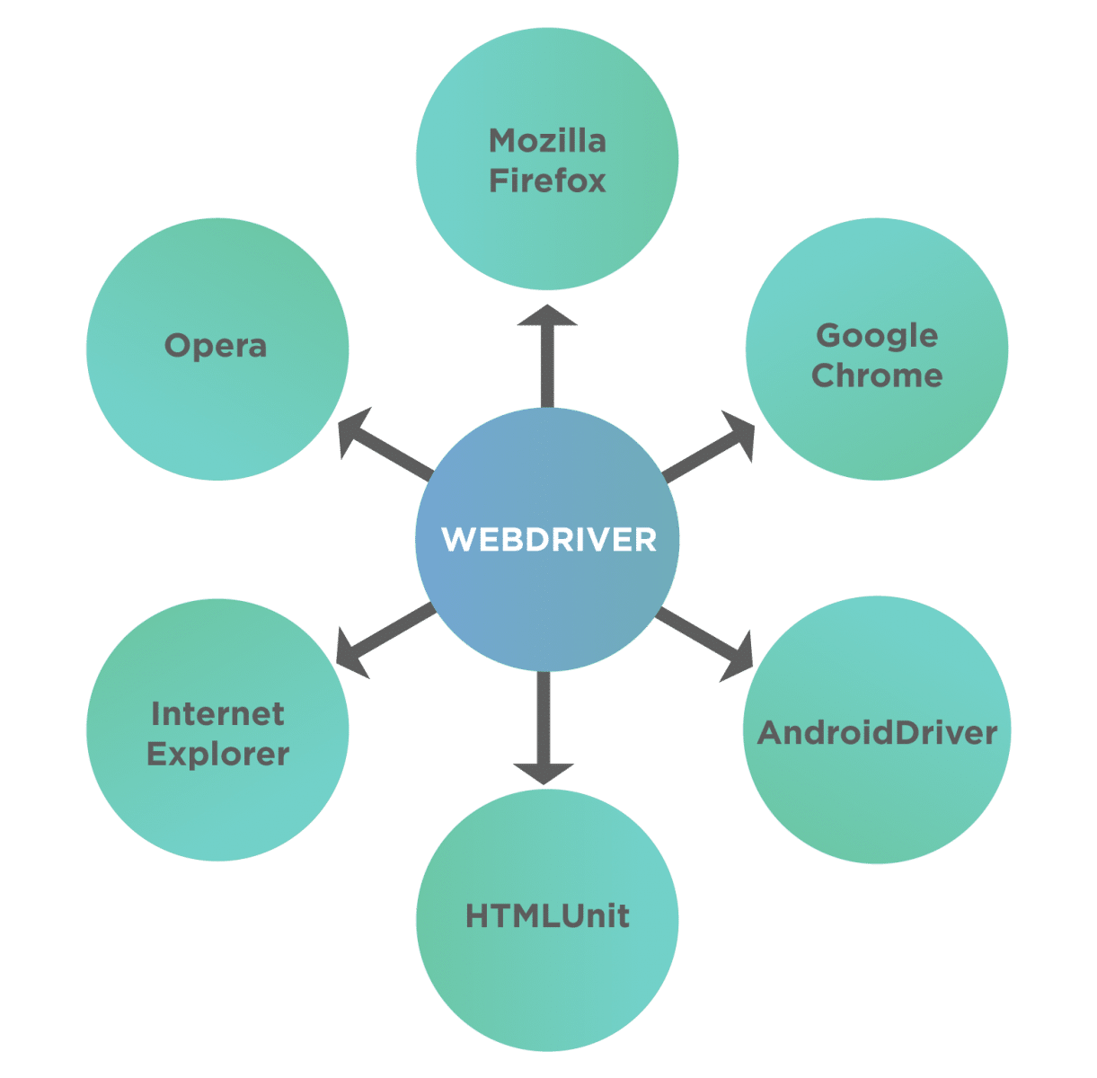
Why Selenium WebDriver is popular?

Slide 10
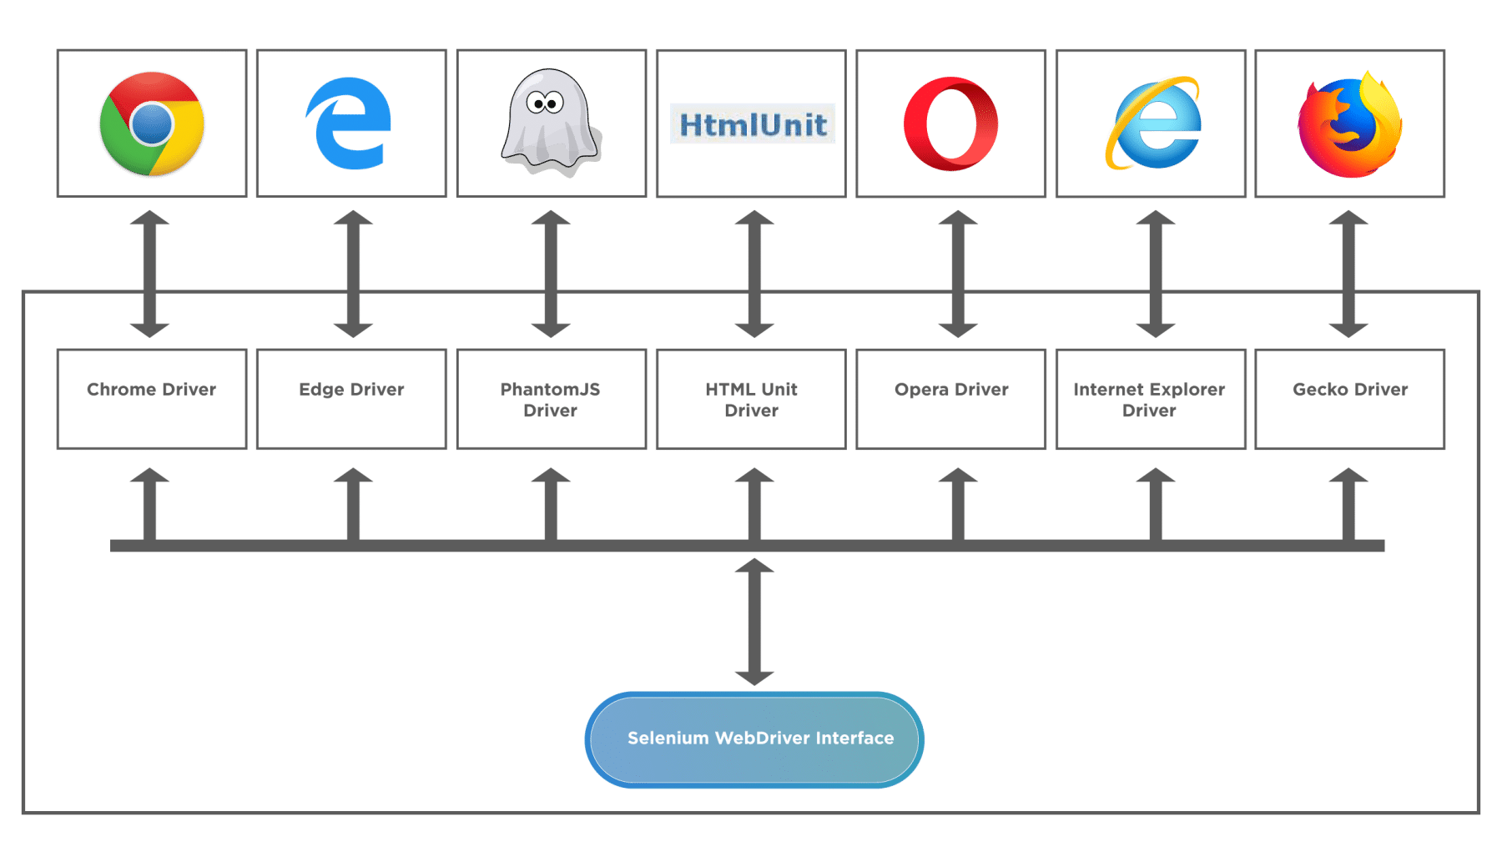
Various browsers and their respective browser drivers

Slide 11
Advantages of Selenium WebDriver Architecture
It is open-source, supports many languages, and is compatible with many operating systems.
Selenium WebDriver architecture is designed to support cross-browser testing and parallel testing.
Selenium WebDriver supports integration with various frameworks like Maven, and ANT for code compilation.
It also supports integration with testing frameworks like TestNG to improve automation testing and reporting.
Selenium can be integrated with Jenkins for CI/CD purposes.
Selenium has strong community support which makes troubleshooting pretty easy.
Selenium Architecture enables us to implement user gestures like the mouse cursor and keyboard actions like click, double click, drag, and drop, click and hold, etc.
With Selenium, you can write your test scripts in the language with which the web application was coded, thus speeding up test cycles.
Selenium does not require us to start any server before testing and provides a direct interpretation of code onto the web services.
The architecture of Selenium enables us to simulate advanced browser interactions like clicking the browser’s back and front buttons.

Slide 12
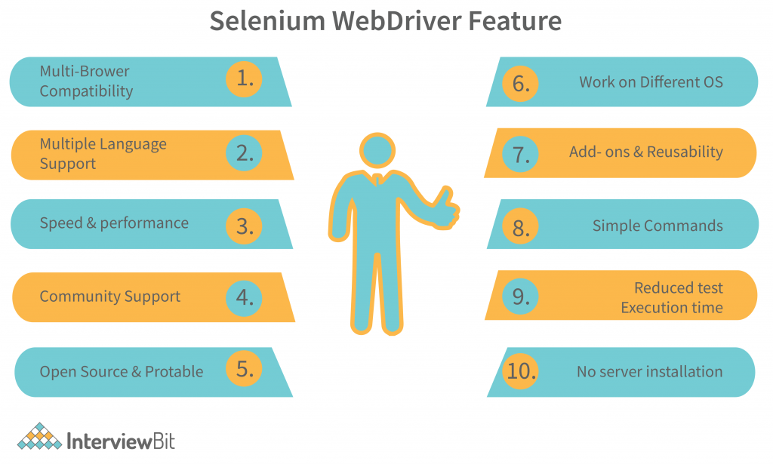
Feature

Slide 13
Disadvantages of Selenium WebDriver
Selenium does not support testing of Windows applications as it works only on web applications.
Selenium depends on third-party frameworks like TestNG and Cucumber for reporting, as it does not have inbuilt reporting features.
Selenium architecture is not prepared to handle dynamic web elements accurately, thus affecting test results.
Selenium does not handle frames and pop-ups efficiently.
Selenium does not automate captcha, barcodes, and test cases that involve fingerprints.
Selenium does not support the automation of video and audio elements.
Selenium requires knowledge of programming languages, thus making test script authoring slightly hard.
Test management tasks cannot be performed with Selenium, while tools like UFT/QTP support ALM integration.

